Slide 1
IT Services
Board Presentation
Lowell Ballard | Director of Technology| October 21, 2020

Slide 2
Today’s Update: Key Highlights
Who We Are
Accomplishments
Strategic Direction
Upcoming Projects
2

Slide 3
Who We Are – IT Services
Lowell Ballard Director
► Jaime Salinas Service Desk
► Tim Davis Application Services
► Chris Hoesel Operations Services
Systems Analysts & Developers
Infrastructure Analysts
Info Security
IT Trainer
Assistant
Service Desk Analysts & Field Technicians
Three Teams, 24 Staff
3

Slide 4
Who We Are – IT Management
4

Slide 5
Who We Are – IT Services Team
5

Slide 6
Service Objectives for 2019/20
Client Satisfaction: >90% customer satisfaction
Financial Effectiveness: <4.6% of institutional revenues spent on IT
Service Delivery: >40% requests resolved on first contact
Institutional Outcomes: >22% of forms able to submit online
Leading Indicators Tracked
Reduce Outages: Single Points of Failure addressed
Reduce Costs: Identified potential cost savings realized
Reduce Risks: IT Security controls addressed
6

Slide 7
COVID Related Accomplishments
Remote Files OneDrive/SharePoint
Adobe Sign – Online Forms
Remote Access Web Site
VPN for All Employees
Remote Work – Teams and Zoom
Student Accounts
Remote K12 Classrooms - Teams
New Workstations Ordered
7

Slide 8
Upcoming Projects (From Last Year)
Dashboard in a Day (Power BI)
OneDrive/SharePoint Online
Project Service/MS Teams
IT Service Management System
School Data Sync
Conference Room AV Upgrades
IT Security Enhancements
8

Slide 9
Upcoming Projects (Current Status)
Dashboard in a Day (Power BI)
OneDrive/SharePoint Online
Project Service/MS Teams
IT Service Management System
School Data Sync
Conference Room AV Upgrades
IT Security Enhancements
9

Slide 10
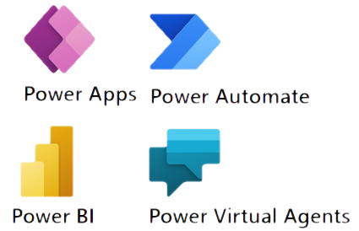
Strategic Direction: The Cloud
TECHNOLOGY | A DIVISION OF HARRIS COUNTY DEPARTMENT OF EDUCATION
10
Notes:
Pre-built, closer integrations:
Security
Workflows
Forms
Reports
Automatic upgrades, new features
Same as Fortune 500 uses
Larger Ecosystem
Easier to Hire
Better Career Paths
Easier migrations from IaaS, to PaaS, to SaaS

Slide 11
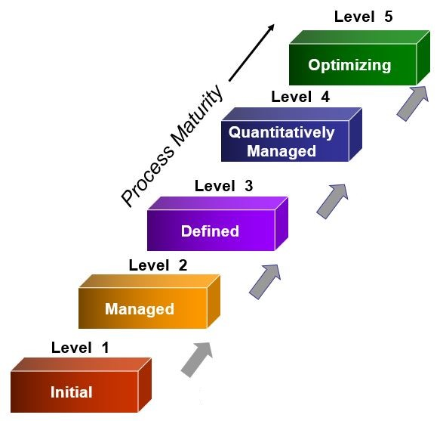
Upcoming Projects (Plans for 2021)
IT Training of “Citizen Managers”
Process Owners
Data Managers
Project Managers
Trainers
Security Administrators
Process Management (Promapp)
Decision Support - Dashboards (Power BI)
Enhanced Security
Additional Projects
Identified from External Best Practice Assessments
11

Slide 12
IT Security/Risk Reduction
Security Committee and Policy Update
Security Awareness Training
Security Controls Compliance (NIST SP 800-53)
Microsoft and Azure Defender – Utilize New Features Institution-wide
Data Loss Prevention
Security Incident and Event Management
Multi-factor Authentication (Off Site)
Disaster Recovery Planning, Removal of Single Points of Failure
12

Slide 13
IT Services
Board Presentation
Lowell Ballard | Director of Technology| October 21, 2020

Slide 14
Technology Budget
$3.9M
Central Technology Budget FY19
4.1% of est. Institutional Revenues
Education Average is 4.9%*
(Professional Services Avg. is 4.7%)
*Source: Gartner IT Key Metrics Data 2012
Cross-Institution, Includes Higher Ed
14

Slide 15
Services Provided
Applications:
42 Supported Services
343 Reports, Workflows and Forms
56 Databases
Help Desk:
9,649 Requests Fulfilled
84% Resolved without Escalation (70% Industry Avg.)
79% Resolved by Target Date (70%-85% Industry Avg.)
>1,000 Staff Supported
18 Connected Sites
>3,000 Students at those Sites
1,834 Devices
803 Telephones
Operations:
217 Virtual Servers
34 Physical Servers
184 Terabytes of Storage in Use
163 Network Switches
104 Wireless Access Points
Internet Bandwidth:
300 Mbps - Administrative Sites
50 Mbps - Schools
20 Mbps - Head Start Sites
15

Slide 16
Strategic Direction: The Cloud
TECHNOLOGY | A DIVISION OF HARRIS COUNTY DEPARTMENT OF EDUCATION
16
Notes:
Pre-built, closer integrations:
Security
Workflows
Forms
Reports
Automatic upgrades, new features
Same as Fortune 500 uses
Larger Ecosystem
Easier to Hire
Better Career Paths
Easier migrations from IaaS, to PaaS, to SaaS

Slide 17
Accomplishments
Email to Office 365 Cloud
HCDE LMS to Azure Cloud
School Workstation Refresh
IT Staff PowerSchool Training
Full Budget Line Item Review
10 Systems Consolidated
eFinance ERP System Upgrade
Windows 10 Upgrades (75% Completed)
17

